Slide 1
www.MINEPORTAL.in
ONLINE TEST SERIES FOR GATE MINING COAL/METAL FIRST/SECOND CLASS COAL INDIA MT MINING EXAM OVERMAN/SIRDAR EXAM OTHER PSU MANAGEMENT TRAINEE EXAM FREE STUDY MATERIAL/VIDEO LECTURES ONLINE ORDER MINING BOOKS CALL/WHATSAPP-8804777500 www.fb.com/mineportal.in

Slide 2

Mine Rescue Operation in India
&
World’s Best Practices
Presented by:
Mr R K Jain,
Head(Safety & Environment)
Jharia Division, Tata Steel Ltd,
Date: 22.04.2016

Slide 3
History of disaster’s in India since 1910.
No. of person
No. of disaster

Slide 4
Some Major Disasters in India
Cause of accident | Name of mine | Date of accident | No. of persons
 |  |  | Killed
Firedamp and Coal Dust Explosion | Amlabad Colliery Chinakuri Colliery Dhori Colliery Jeetpur Colliery Kurharbaree Colliery Parbelia Colliery Poidih Colliery Sudamdih Colliery Bhatdih colliery | 5.2.1955 19.2.1958 28.5.1965 18.3.1973 24.7.1935 4.1.1923 18.12.1936 4.10.1976 06.09.2006 | 52 176 268 48 62 74 209 43 50
Inundations | Chasnalla Colliery Gaslitand Colliery Newton Chikli Colliery | 27.12.1975 27.9.1995 10.12.1954 | 375 64 63
Mine Fires | Jagannath Opencast Project Loyabad Colliery New Kenda Colliery | 24.6.1981 30.1.1936 25.01.1994 | 10 35 55
Air Blast | Jamuria Colliery Parascole West Colliery | 08.10.1943 06.07.1999 | 12 5

Slide 5
Some Major Disasters in India
Cause of accident | Name of mine | Date of accident | No. of persons
 |  |  | Killed
Rock Bursts and Bumps | Champion Reef Gold Mine Champion Reef Gold Mine Dhemo Main Colliery Sodepur Colliery | 19.4.1952 and 30.6.1952 27.5.1955 12.07.1952 22.02.1943 | 30 10 12 13
Roof Fall | Godavarkhani No. 8A Kessurgarh Colliery Sitalpur Colliery Topa Colliery | 17.10.2003 9.8.1975 15.10.1910 16.7.1982 | 10 11 12 16
Side Fall | Bhatti Bajri Mines Kawadi Opencast Coal Mine Rajupalem Baryte Mines Shivrajpur Manganese Mine | 10th, 16th and 24th January 1983 24.6.2000 29.9.1957 | 29 10 11 12
Collapse of Pillars | Bhowrah Colliery Rawarwara Colliery West Chirimiri Colliery | 4.2.1916 14.4.1923 11.4.1968 | 24 16 14

Slide 6
Chronology of Disasters & Preparedness in India
In 1897
In 1901
First Indian Mines Act which came into force on 22nd March, 1901
In 1923
The first mine rescue station in India was established in Kolar Gold Fields
Two disaster took place one at Kolar Gold field & another at Khost coal mine in Baluchistan

Slide 7
Chronology of Mine Rescue System in India
In 1923
In 1939
The first coal mines rescue rules were promulgated in India
In 1941
Two central rescue stations were established at Dhansar (Jharkhand) & Sitarampur (West Bengal)
In 1985
In 1959
The first mine rescue station in India was established in Kolar Gold Fields
Mine rescue rules were modified
Central Coal Mines Rescue Station Committee (CCMRSC) was formed.
The Coal Mines Rescue Rule 1959 replaced by the Mines Rescue Rules 1985
Present
46 Rescue Stations in Coal and 6 rescue stations in Metal mining industry are functional in India
13 rescue stations in collieries and 6 rescue stations in Metal mines were established.
Currently Indian Rescue is Governed by Directorate General of Mines Safety, there is need to develop one Central mines rescue station at India level under ministry of coal which shall governs all mines rescue stations.

Slide 8
Worlds Best Practices

Slide 9
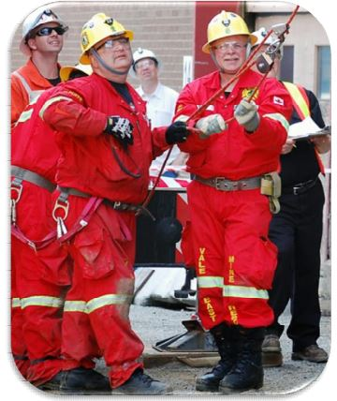
Best practices of Mine Rescue in Canada
Similarities Across Canada
All rescuers are volunteers.
Mines are typically modern and highly mechanized.
Most mines have mutual aid agreement with neighbouring operations.
Competitions are integral to maintaining high standards.
Mining is a safe industry as compared to many other industrial sectors.
Risks and Hazards
Emergency response capability is mandated for underground and surface mines
Respond to fire and non-fire situations
Massive geography and remoteness of mines requires they establish and maintain sustainable emergency response capability.
Typically, rescue teams are highly skilled and well equipped to handle every foreseeable emergency.

Slide 10
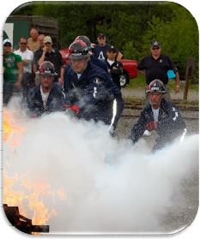
Best practices of Mine Rescue in Canada
Establishing Response Capability
Owners/Employers are legislatively required to conduct a risk assessment and determine types and quantity of rescue equipment, number of trained rescuers necessary to ensure emergency response capability.
Types of Emergency Responses
Fires-Mobile equipment, Electrical equipment, Structural
Collapses, falls of ground and rock bursts
Explosive gasses, methane, sulphide dust, coal dust
Rescue Equipment
SCBA (Drager and Biopak)
• Extrication
Lifting Bags,
Hydraulics,
Jaws of Life.
• Rock breakers, bolt cutters
• High and low expansion foam, CAFS, water and extinguishers
• High angle rescue equipment

Slide 11
Best practices of Mine Rescue in China
Principle for emergency rescue
Rescue actions should be people-oriented, safety and put life of people as the top priority.
“No one left behind and never give up”.
Emergency response capability is an important part of
governance capacity of a country

Slide 12
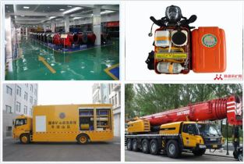
Best practices of Mine Rescue in China
Focusing on structuring emergency rescue system to promote the building of mine rescue teams
463 full time mine rescue teams have been set up. These full time rescue teams have 28200 rescuers in total.
An overarching framework for mine rescue system-
7 national level mine rescue teams- responsible for carrying out rescue operations addressing major and complex mine accidents.

Slide 13
Best practices of Mine Rescue in China
Capacity-building
Focussing on four capacities
Emergency Response
Emergency
Transportation
Professional Rescue
Comprehensive Support
The “6+1”achievement have been made during the building of national mine rescue teams.
The 6 achievement means: one standard, one system(norms), one set of education and training materials, one emergency response plan, one set of demonstration exercises and one set of infrastructure.
The “+1”achievement mean that the mine rescue teams to have its distinctive features with its specialties. These national mine rescue teams can serve as models and guide the building of local and enterprise-based rescue teams, thereby improving mine rescue services in China and improve rescue capabilities.

Slide 14
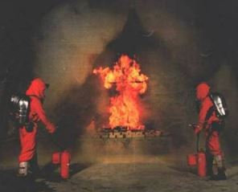
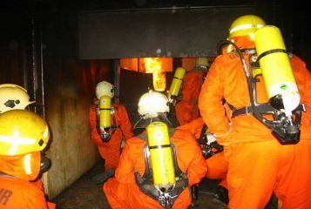
Best practices of Mine Rescue in Germany
Equipment
Self-contained breathing apparatus (SCBA) -4 hours;
Gas measuring device: Dräger X-am 7000 (CO, CH4, O2, CO2)
Climate measurement: electronic psychrometer
Mine rescue telephone
Fire-resistant suit
Training
5 rescue brigade exercises per year
2 periods of theoretical instruction per year

Slide 15
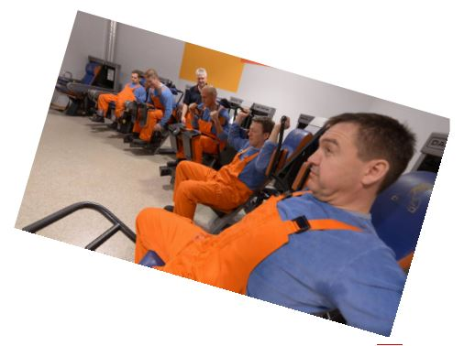
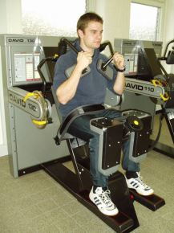
Best practices of Mine Rescue in Germany
Examinations, Tests, Exercises
Annual medical examinations
Fitness test at least twice a year
5 breathing protection exercises
Strength test
Test for all rescue brigade members
4 of 6 exercises have to be passed( standards Nm/kg, depending on body weight )
Strength test for muscles of back / abdomen, shoulder / breast, leg tensors and extensors

Slide 16
Best practices of Mine Rescue in Germany
According to current regulations and laws the mining rescue services are made up of two divisions:
mining rescue brigades at premises of mining operations,
professional entities that deal with mining rescue jobs.
In the Polish mining industry there are three professional entities that deal with mining rescue jobs (rescue units):
Central Mines Rescue Station (CSRG) in Bytom: runs as a public limited company owned by the State Treasury with the aim to cover needs of the coal mining industry and mines of some other minerals,
Rescue Unit for Copper Mining and Smelting Industry in Lubin: established as the rescue services for the KGHM (Polish Copper, plc.) operations to cover own needs of their plants.
Polish Crude Oil and Gas Mining (PGNiG) with its division called Rescue Station for Borehole Mining Operations: established as the rescue services for the PGNiG operations to cover needs of crude oil and gas extraction facilities and crude oil and natural gas exploration.

Slide 17
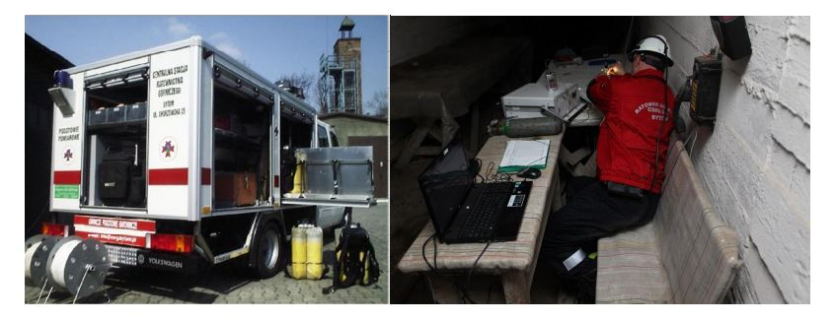
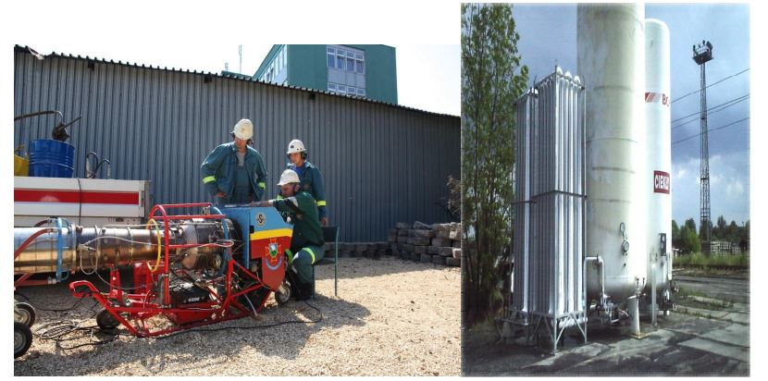
Best practices of Mine Rescue in Poland
Specialized emergency teams: for measurement operations, to take measurements and determine condition of air in underground areas of mines and presence of flammable gases when rescue actions are in progress and to asses degree of explosion hazards for potentially explosive gas blends.
For inertization of mining air, to prevent explosions of flammable gases by neutralization of
them by means of inert gases.

Slide 18
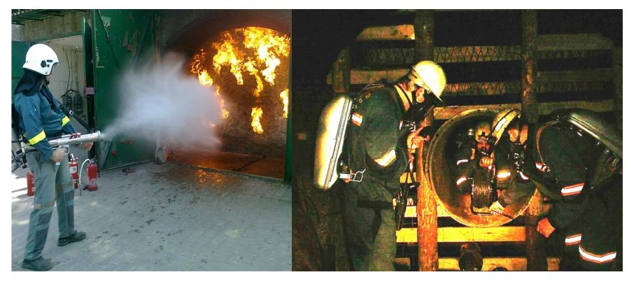
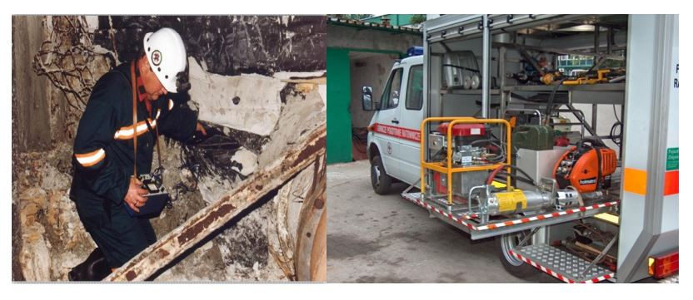
Best practices of Mine Rescue in Poland
For fire fighting, to carry out rescue jobs directly related to active extinguishing of underground fires and/or to carry out operations aimed to isolate areas with smouldering or burning coal where
stoppings of various designs or separating layers of chemical or mineral compounds are used for isolation.
For mining and technical operations, to carry out specialized jobs during fire fighting operation
as well as after roof falls or rock bumps,

Slide 19
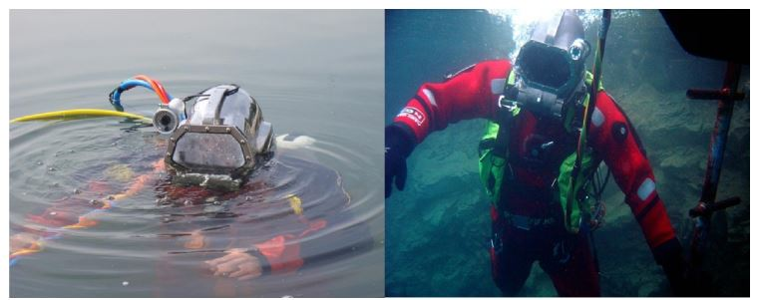
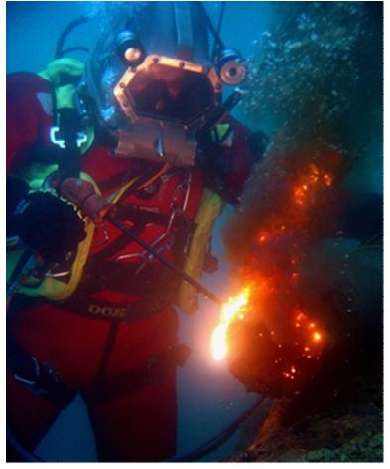
Best practices of Mine Rescue in Poland
For water engineering, to refine consequences of water outbursts into mining excavations,

Slide 20
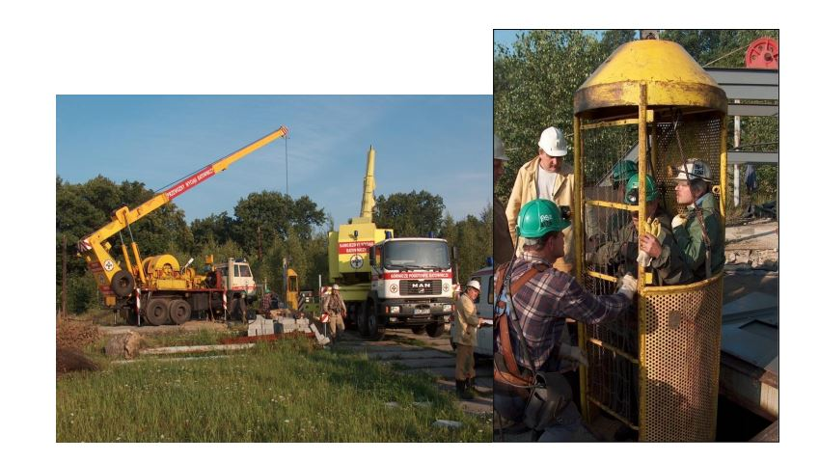
Best practices of Mine Rescue in Poland
For portable (transportable) rescue hoists, to carry out emergency operations in shafts of underground mines, to evacuate personnel and execute other rescue operations in shafts or large-diameter extraction boreholes as well as to carry out emergency and inspection jobs and checks both in shafts and in large-diameter boreholes.

Slide 21
Best practices of Mine Rescue in Poland
Efficiency of the rescue system
Efficiency of the current Polish system for integrated mining rescue engineering has been confirmed in practice, with particular consideration of the optimized management under crisis circumstances provided that the undisturbed communication between components of the system is guaranteed.
The most important factors that enabled formation of the system and to achieve its current status are the following:
Application of unified or very similar rescue technologies,
Advanced equipment, mostly unified it terms of manufacturing series,
Training systems with established syllabus for theoretical classes and practical tutorials,
High standards of medical examinations.

Slide 22
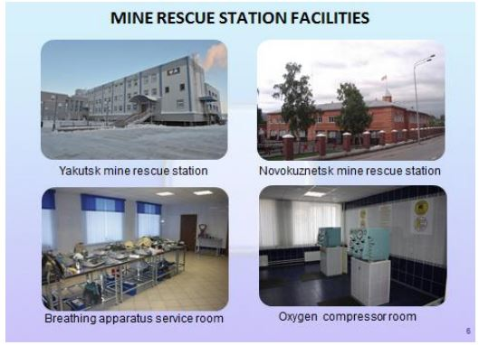
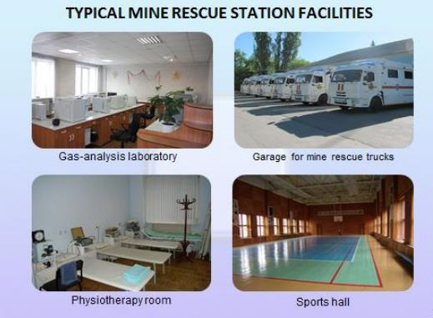
Best practices of Mine Rescue in Russia

Slide 23
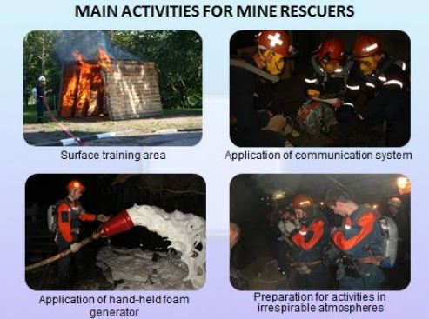
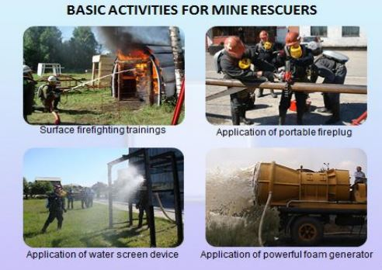
Best practices of Mine Rescue in Russia

Slide 24
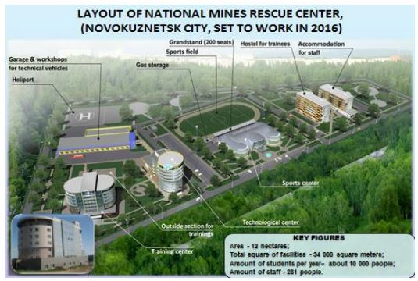
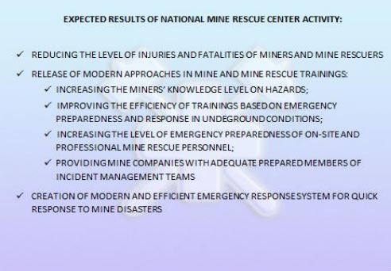
Best practices of Mine Rescue in Russia

Slide 25
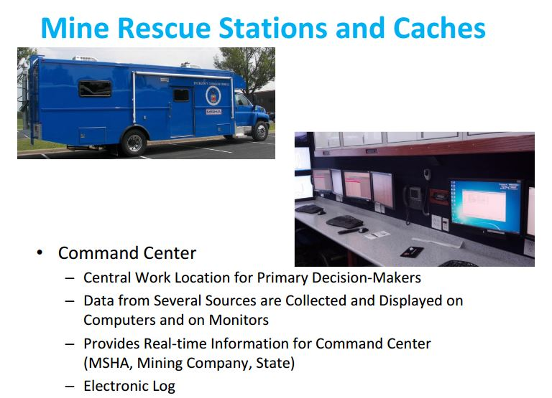
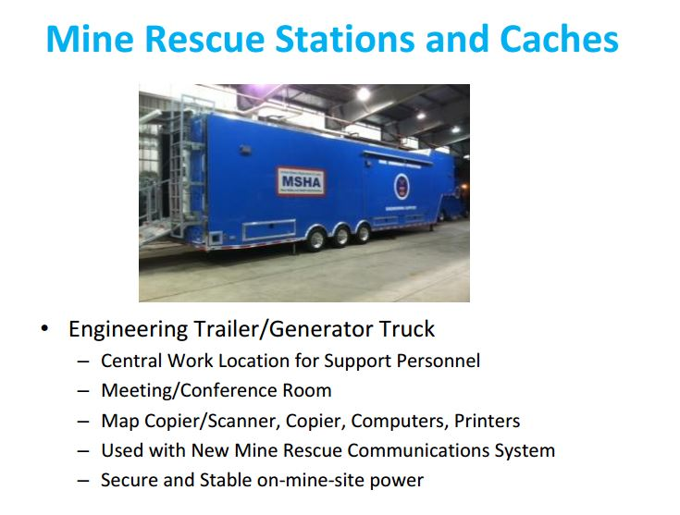
Best practices of Mine Rescue in USA

Slide 26
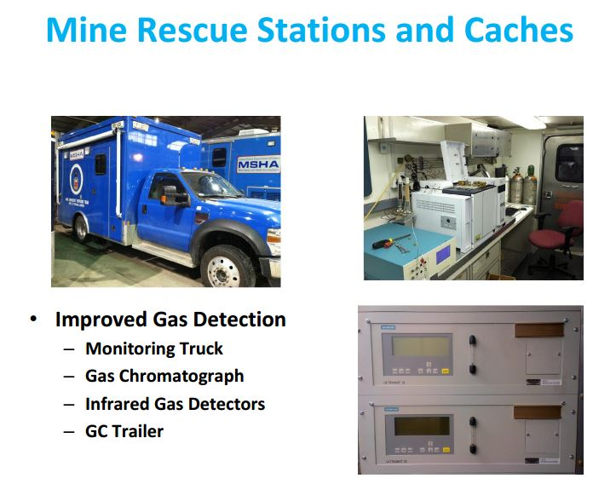
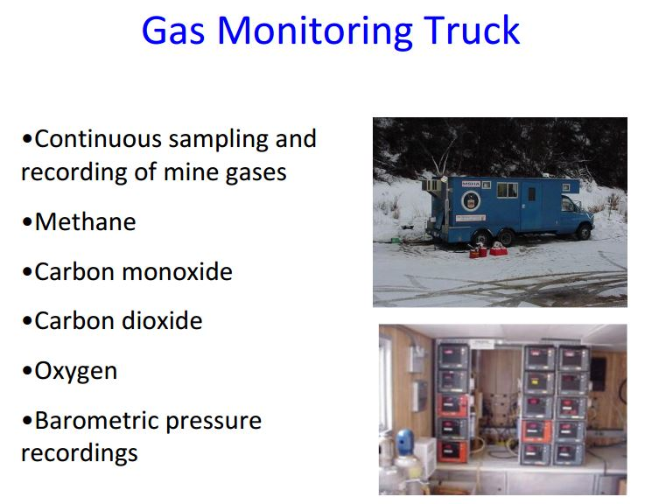
Best practices of Mine Rescue in USA

Slide 27
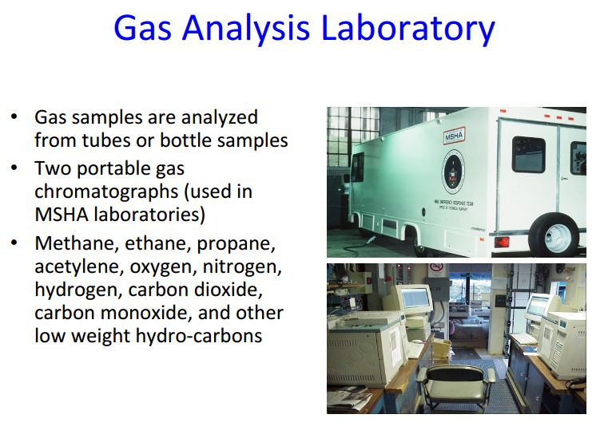
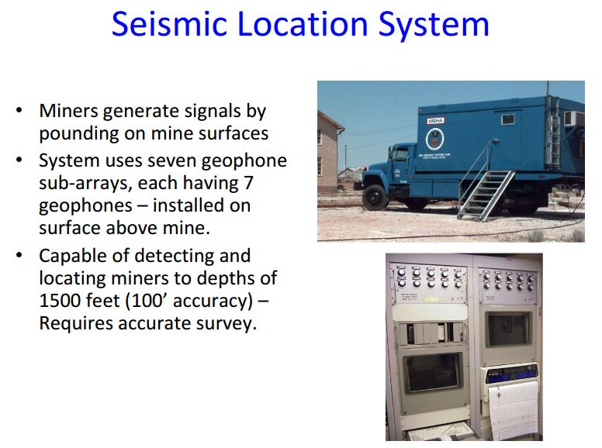
Best practices of Mine Rescue in USA

Slide 28
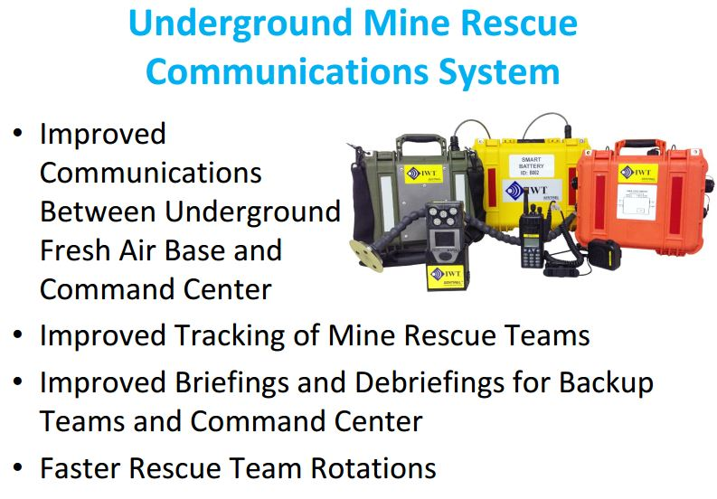
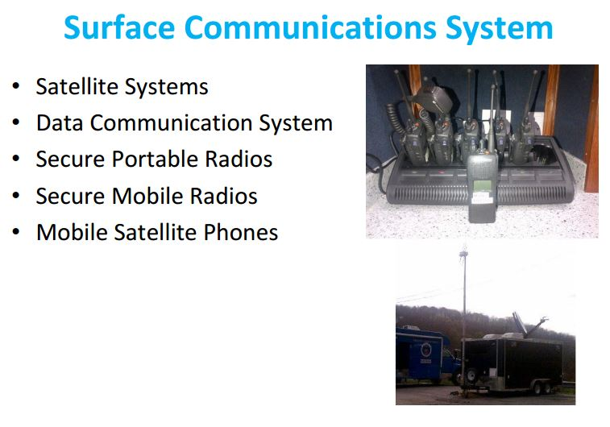
Best practices of Mine Rescue in USA

Slide 29
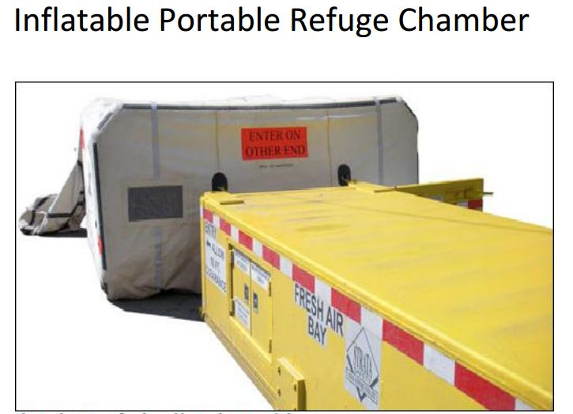
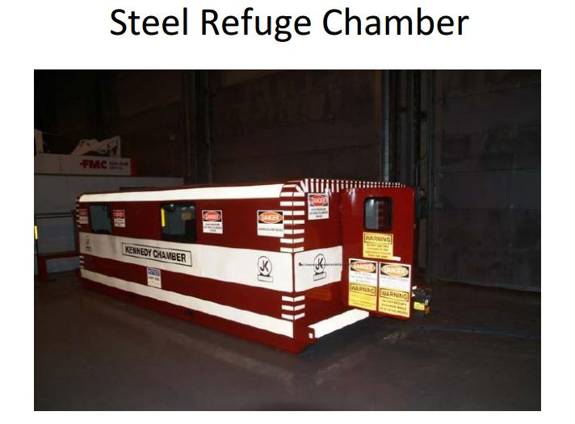
Best practices of Mine Rescue in USA

Slide 30
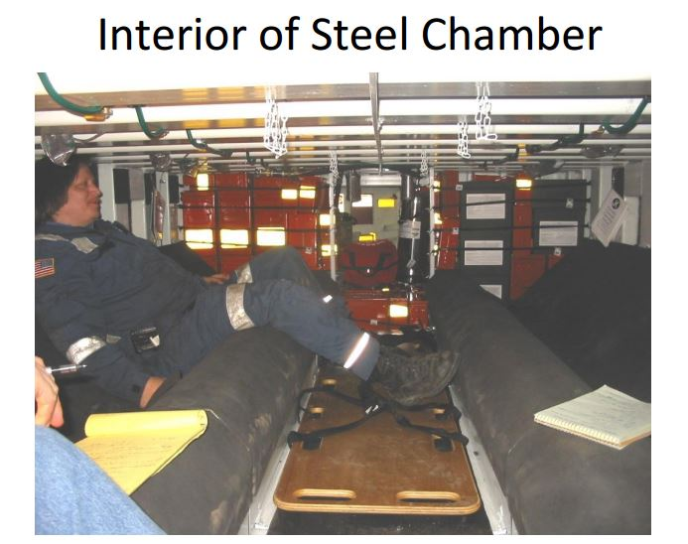
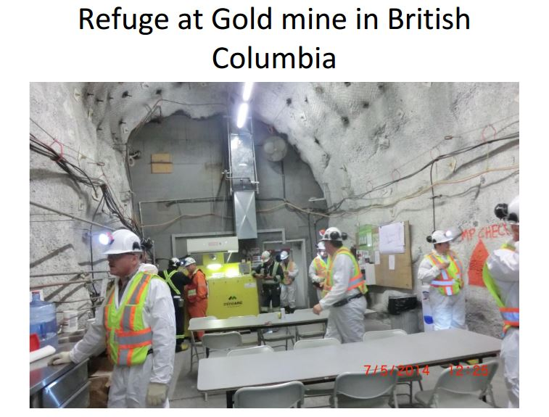
Best practices of Mine Rescue in USA

Slide 31
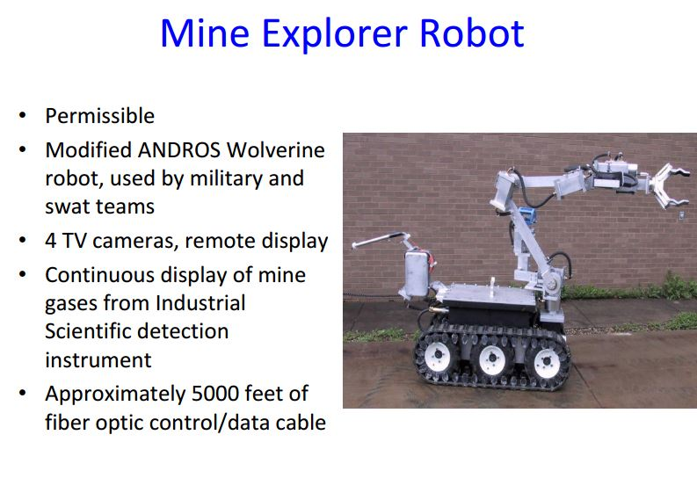
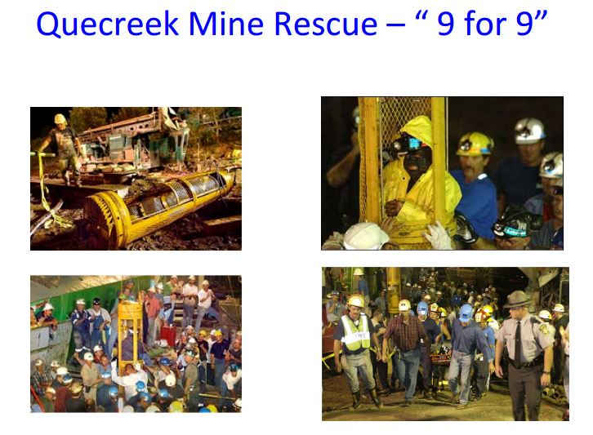
Best practices of Mine Rescue in USA

Slide 32

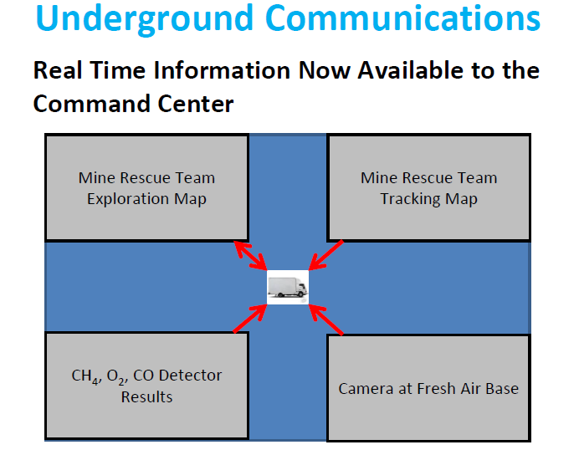

Communication System for Rescue
Jharia Divison

Slide 33
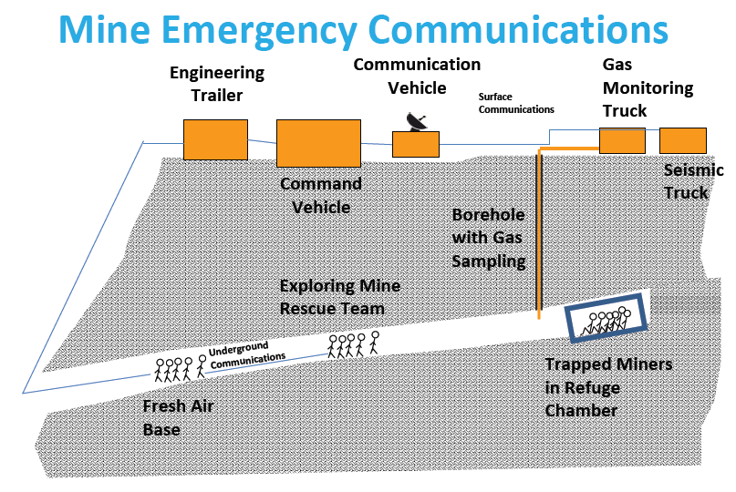
Communication System for Rescue
Jharia Divison

Slide 34
Suggestion for Improvement of Rescue practices In India

Slide 35
Reorganisation of rescue structure at India level.
Detail Procedure to be developed for Rescue operations in methane/non-methane fields
Fire-fighting operation in the event of fire in a blind heading (500m) with separate ventilation
Develop capabilities for Rescue operations in the event of outburst of gases and rocks.
Develop capabilities for Underwater penetration in mine headings.
Rescue operations in the event of water or water with loose rock material penetration into the headings.
Establishing contact with people in danger caused by water and their evacuation
Rescue operations connected with electrical power and mechanical failures in headings.
Rescue operation under difficult thermal conditions.
Rescue operation in the event of reservoir fluid eruption and fire when looking and mining for oil and natural gas .
Use of simulation and 3D virtual reality training theatre.

Slide 36
Suggestion
to Improve
“All India Mines Rescue Competitions”
G.S.Tiwary
Sr.Mgr (Training)
Mail id: gs@tatasteel.com, Contact No. 9204065510
Professional Training Institute, Jharia

Slide 37
Lottery System
Existing Procedure | Suggested Procedure
Team wise: As this is a competition, so make it fare competition not a fun. 1. All the information shared by one team to another team of the same company. 2. Mistakes committed by team A is rectified by team B later 3. Making video and sharing the important information to next team of the same company. | Company wise Not given opportunity to any team to rectify the mistakes. Team B of same company will follow team A of the same company at same lottery number ( say 4) so at 4 A & 4 B. If possible keep team completely isolated from rescue gallery.

Slide 38
March Past
Rule of single file has been standardised
Four judges are deployed for assessing the march past.
Existing Procedure | Suggested Procedure
Some team takes start with double file, merged in single file during marching in straight line, which is violation of rule to make march past in single file. Serial number given in list which is announced by anchor and position with name written on helmet is mismatched. ( The reason behind the this violation may be to make the file good looking so captain the member as per height) However the marking done as per the list circulated to judge and no marking for 7th member. | Keep March past out of scope of competition and give consolation prize to best performer. 1. No such strict judging will be required 2. Only feedback of chief judges or Guest of honor will decide at the spot. 3. Position the member as per height for making the file smart looking on captains decision.

Slide 39
Suggestion to Improve All India Mines Rescue Competitions
Theory
Existing Procedure |  |  |  | Suggested procedure
Type | Full Marks | Duration (Min) | Mode | Type | Full Marks | Duration (Min) | Mode
Theory | 100 | 30 | Oral | Theory | 200 | 30 | Oral
First Aid | 100 | 30 | Oral | 1. Merge to one section only 2. 100 objective type question a. MCQ ( Multiple choice question) b. Fill up the blanks c. True/ false, Pictorial Identification 3. Question Section: a. First Aid-30, b. Rescue Rule-30, c. Gas/Fire/Equipments-40 4. Question will be displayed over LCD Projector 5. In case of tie between team time count is important 6. Answer will be given by only one member after discussion with team 7. Just after reply of team correct answer will be displayed for learning Benefits 1. Only one time paper work & result preparation 2. More area of exposure 3. Less number of judge will be required
Statutory | 100 | 30 | Oral
Opportunity of Improvement: 3 judges required 3 Times paper work & result preparation Only 40-50 question No correct answer shown to participant

Slide 40
First aid practical section
Existing Practice | Suggested
1. Practical section inside the room 2. Task given by Doctor to team members in three section 3. CPR on mannequin 4. Two doctors for judging the same one in theory & one for practical | It is partially duplicated in Rescue work too Care of patient during transportation of patient on stretcher Diagnosis of the casualty in obscure or in clear environment 1. Inclusion of class room first aid practical in rescue work in field 2. Include Doctors in judge panel in the field during rescue work.
( Approach to patient & care during transporting in mine is key factor)

Slide 41
Fresh air base
Inclusion of original plan is appreciable.
Choice of multiple equipment was also very good
Existing Procedure | Suggested Procedure
Captain has not coupled up in the FAB Only rescue plan has given in FAB During plan discussion of recovery team members involvement could not be possible due to coupled up specially in BG-174 equipment. | First report in mine entry for making attendance Report at FAB considering FAB in underground or at surface Rescue & recovery task shall be given to captain simultaneously Captain will also coupled up with team members. At least two judges is required for judge effectively.

Slide 42
Rescue work ( Simulation Improve the knowledge not skill)
Inclusion of original rescue plan is appreciable.
Choice of multiple equipment was also very good
Mannequin provided
Smoke provided
Existing Procedure | Suggested Procedure
Team Pace Team members are allowed to run with machine. Route followed Only one route of approach Chalk marking Rescue gallery Rescue gallery on open surface ( Huge difference in actual scene) Rescue Return Time: Indian Pattern 10- 15 minutes in rescue and 10 minutes in recovery and waiting time in between the rescue and recovery work is 15 minutes to 45 minutes which is worthless. International Pattern 1 hour | Team Pace Don’t allow running with Machine Route followed Provide multiple entry ( Two intake and one return) Permanent route marker as glow stick etc. with arrow mark/point. Rescue gallery Make it possible in training gallery (may be partial or full ) and if partial half way outside. Best in model underground mine To give the fill of underground environment, competition may be in night in flooded light Rescue Return Time: In original rescue work, statutory return time in irrespirable environment is not more than 1 and ½ hour. As it is a mock of the same so return time must be of 1 and ½ hour including recovery work in a stretch.

Slide 43
Rescue work ( Simulation Improve the knowledge not skill)
Existing Procedure | Suggested Procedure
Communication system In Indian procedure some mine keep telephone for shake only. In International pattern communication is done for each & every step/Item/location/conditions to BO ( Briefing officer) at FAB and updating the plan both at working environment and FAB. | Communication system 1. Install telephone at FAB and if possible in rescue/recovery galley in working condition that all the team has to check for its working and in emergency they may contact. 2. No need of each and every step/Item/location/conditions communication to BO at FAB and updating the plan only at filed and verified with original rescue plan kept with BO at FAB or what is the actual condition of the mine during exploration and which will refer as input for next team. 3. Communication may be used only for emergency situation or critical decision.

Slide 44
Rescue work ( Simulation Improve the knowledge not skill)
Existing Procedure | Suggested Procedure
Inclusion of International Pattern Play card all along gallery kept, captain has first check play card instruction & than respond or vice versa. Identification of dead body Checking of gas Checking of roof in bad roof in simulated form Explosive mixture zone Low height zone Ventilation coursing High temperature zone Control of ventilation | Inclusion of International Pattern 2. First let the team demonstrate than display of play card if needed or procedure is correct. Identification of dead body – Let check the team first than display of card for body/live/fracture. Checking of gas – Keep 10 point to check gas if required and if procedure is correct than display of gas reading. Checking of roof is needed in bad roof /side condition, low height zone, near goaf etc. Explosive mixture zone Low height zone- Make low height say 4 feet height gallery, solid roof so that two prop can be erected ( Quick setting/Screw prop) Ventilation coursing- Provide quick setting prop, brattice cloth, nail etc and solid roof to erect brattice cloth High temperature/dense smoke / heavily dusted Control of ventilation- Provision of regulator, Tipple door, Auxiliary fan in operation with duct, Water / Stowing Pipe joining- with tools & tackles Introduction of pyrometer to check the symptoms of heating or point of heating pillar Install Manometer to check the pressure difference of Isolation stoppings

Slide 45
Recovery work ( Simulation Improve the knowledge not skill)
Inclusion of original plan is appreciable in recovery gallery too.
Fresh sand bag with same weight provided to all team member was appreciable.
The height of gallery was also good.
Existing Procedure | Suggested Procedure
Recovery gallery in complete open The method of erection of prop was not proper No provision of ventilation coursing by brattice cloth using quick setting prop. 3. No proper system of method of updating of actual scene in the field on rescue plan. 4. Focused on only sand bag stooping 5. Display of number of sand bag is target setting for next team. | Recovery gallery partially in training gallery and partially in open Rescue & recovery merged in one section only Recovery Hand over of casualty in the field only to the rescue judge Captain will also not uncoupled until completion of recovery work Captain report & feedback will be taken finally at the captain’s report section. Time may be increased to 20 Minutes a. Prop erection b. Ventilation coursing c. Plan updating with appropriate symbol Quantity of sand bag achieved by any team must be confidential.

Slide 46
Captain’s report ( Simulation Improve the knowledge not skill)
Existing Procedure | Suggested Procedure
Captain report only in following format Details of Mine/Owner/Working Place In out time Route followed Work attempted Special Observation Suggestion for next team Details of pressure card | Format to be changed as FAB details – Testing of equipment if any abnormalities observed – What are the different equipment taken as in check list provided to them. Details of Mine/Owner/Working Place In out time Route followed Work attempted Special Observation Suggestion for next team Details of pressure card Condition of Casualties- Pulse/Breathing/Identification/Injury and action taken Details of environmental condition – Gas/Temp- Location, quantity, action taken Sample Details- Type/Location/Time etc.

Slide 47
Selection of Best Captain ( Simulation Improve the knowledge not skill)
Existing Procedure | Suggested Procedure
Individual marks of each event and average marks per member or rescue/recovery/Fab Captains Report marks | Marks sheet should be revised with job responsibility against each member from1 to 6 Add marks of FAB, Rescue and recovery Captain’s report marks. As theory is team performance so nothing to worried. Some technical calculation base test may be included for captain in theory section.
Team Selection
Existing Procedure | Suggested Procedure
The teams shall be formed only from amongst those, who had participated in the Zonal Rescue Competition where applicable, held prior to the AIMRC. Any person, who is a permanent Brigade member at the time of competition or who was a permanent brigade member within 6 months prior to the date of competition shall not be allowed to participate in the competition. | No need of participation in zonal rescue competition. As a member has been released from the department for 15 days to month or more for practice. If this is the fitness before skill demonstration. Than how many practice for actual emergency. Qualification must be one of the criteria for captain and vice captain. For captain at least 2nd class manage certificate and for vice captain Overman/Forman. Give opportunity to Permanent Rescue Brigade for Best or Correct demonstration in Final day function in presence of judge.

Slide 48
Any Questions ?

